Slide 1
Hotel Booking Cancelation Prediction by Machine Learning
By
Uday Bairapaka
119me0034

Slide 2
Agenda
Problem statement
Data given in data set
Visualization
Steps I have done
Chosen model
Conclusion

Slide 3
Problem Statement
Hotel Booking Cancelation Prediction Problem
Type:- Binary Classification Hotel booking cancelation prediction is classic problem to learn and apply lots of data analysis techniques to create best Classification model.
Given with the dataset consisting of details of applicants for hotel booking and status whether the booking application is approved or not. Basis on the a binary classification model is to be created with maximum accuracy

Slide 4
In this project, i will try to predict the possibility of a booking cancel for a hotel based on different factors and also try to predict if they need special requests based on different features. The data set contains booking information for a city hotel and a resort hotel and includes information such as when the booking was made, the number of adults, children, and/or babies, and the number of available parking spaces, among other things

Slide 5
Data given in the data set
Market Segments
Customer Related
Cancellation History
Offline vs Online sources from where the booking is generated and related variables.
Variables describing the type of customer based on stay, whether returning, accompanied by how many etc.
How their cancellations made earlier? etc.

Slide 6
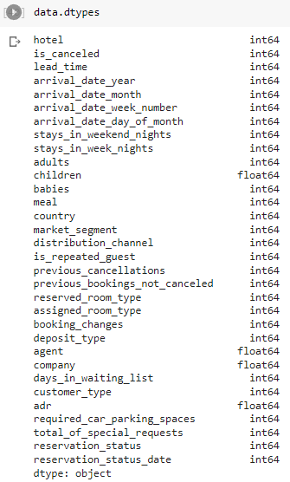
Data types

Slide 7
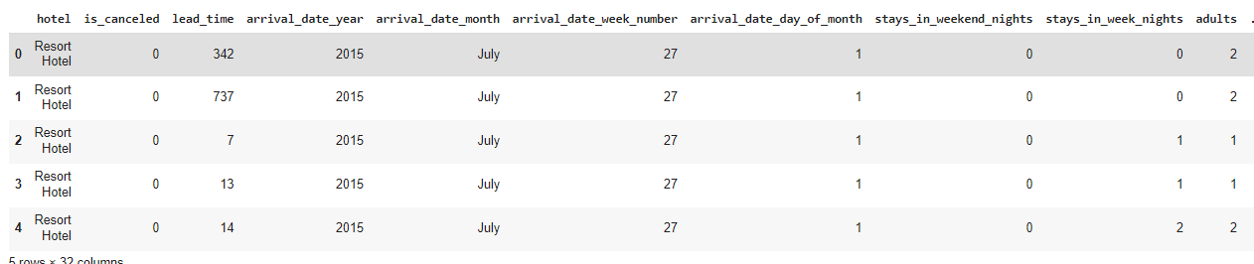
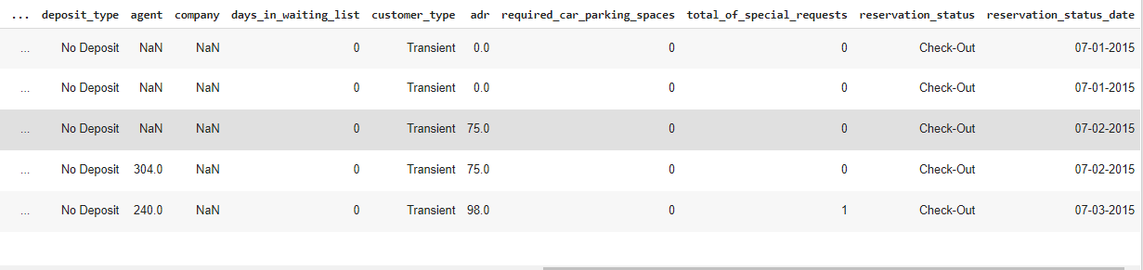
DATA SET TABLE

Slide 8
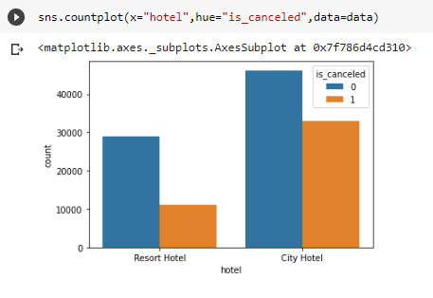
Visualization with interface
Cancellation of hotel booking is mostly done in city hotel compared to resort hotel
In resort, the number of hotel booking cancels was 48000 and the number of bookings was 31000
In resort, the number of hotel booking cancels was 29000 and the number of bookings was 10000

Slide 9
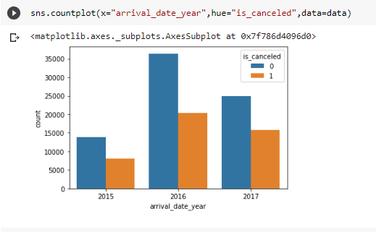
Visualization with interface
Hotel booking cancellations increased from 2015 to 2017, but in 2016 there were more cancels
In 2015, the number of hotel booking cancels was 14000 and the number of bookings was 7000
In 2016, the number of hotel booking cancels was 36000 and the number of bookings was 20000
In 2017, the number of hotel booking cancels was 25000 and the number of bookings was 15000

Slide 10
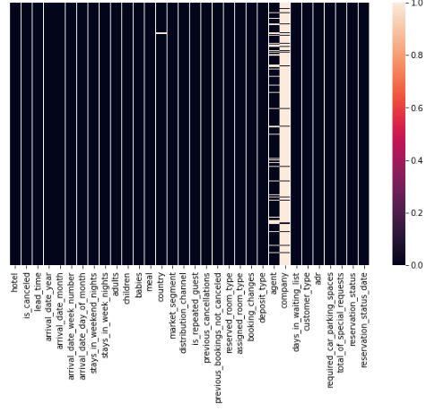
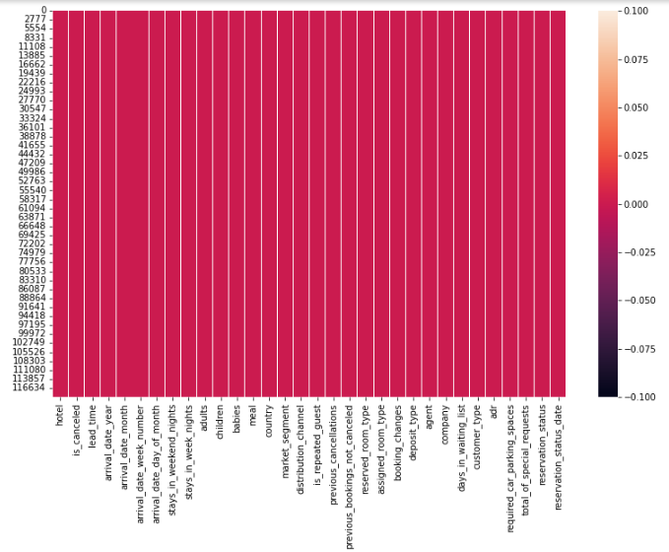
Visualizing null values

Slide 11
Steps I have done
Imported the packages numpy,pandas,matplotlib,seaborn,sklearn,train test split,metrics
Load the Dataset
Explored the data-shape,visualisation
X,y-->train data test data->Fit the model with training data predict with the test data
Predicted with different algorithms like Logistic regression,Decision Tree Classifier and RandomForestClassifier etc.

Slide 12
Chosen Model
Logistic regression : 74% accuracy
Decision Tree Classifier : 100% accuracy
RandomForestClassifier : 99% accuracy
I got 100% accuracy in Decision Tree Classifier so i chose Decision Tree Classifier model . Simple to understand , makes fast predictions and is interpretable.During training, a set of decision trees is built consecutively. Each successive tree is built with reduced loss compared to the previous trees

Slide 13
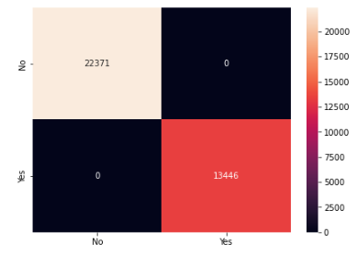
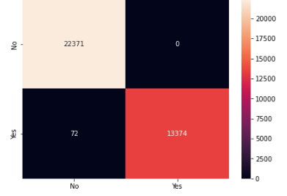
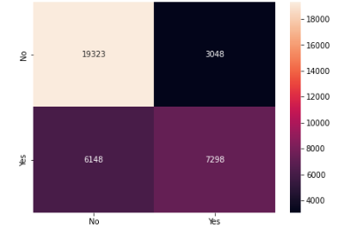
Confusion matrices of
Logistic regression,
Decision Tree Classifier
Random forest classifiers

Slide 14
Conclusion
Reservation cancellations are a major issue for hotels and one of the factors contributing to their loss of income and profitability. I am observed, internet hotel reservation services encourage clients to make many hotel reservations before deciding where to stay, contributing to the rise in cancellations that has been observed over the past few years
Hotels may use this data, for instance, to get in touch with customers the model projected will cancel in order to receive a cancellation early and give themselves more time to resell the room. Alternately, we might make the customer feel special by keeping their reservation and cancelling the ones they had booked at other hotels in the same city

Slide 15
Thank You

